Slide 1
MSAS Tutorial Sequence -Module One-
Written by Garrett Folbe

Slide 2
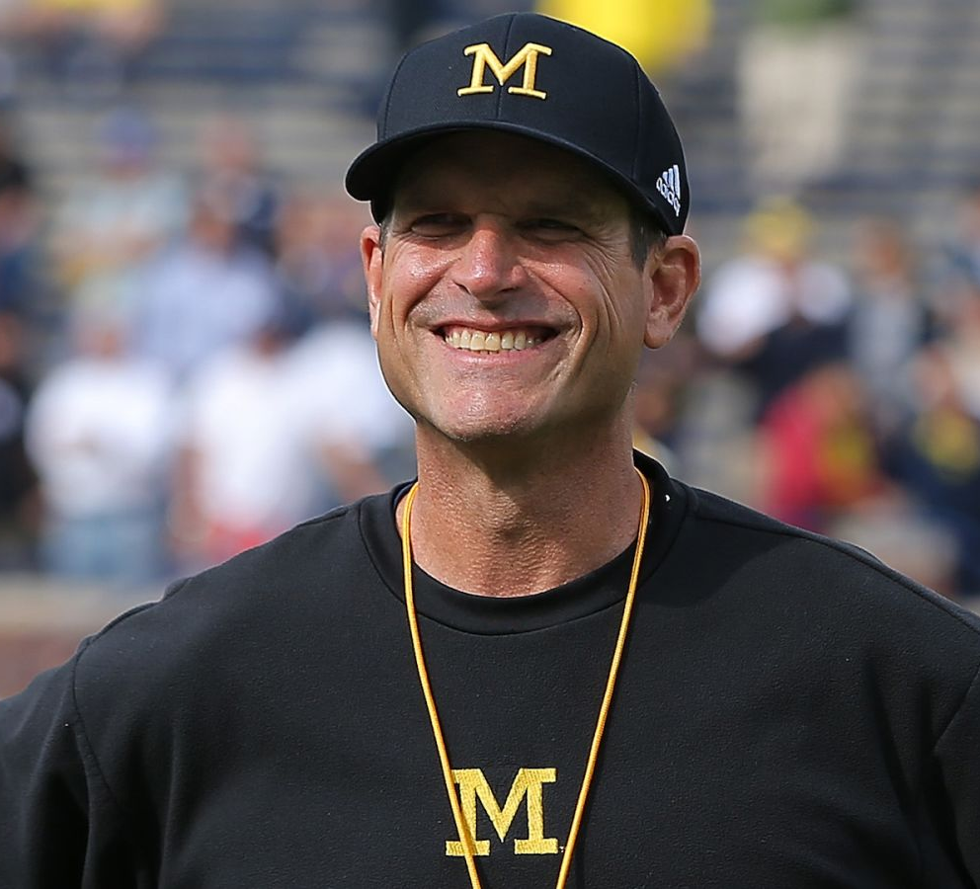
WELCOME
TO
MSAS

Slide 3
What is MSAS?
Designed to introduce you to the world of sports analytics
Give you the opportunity to learn and apply essential skills
Network with other students that have similar interests as you
Work with experienced leaders and faculty members
Talk sports!

Slide 4
What is the point of these tutorials?
Get you set up with a familiar environment
Provide you with a foundation that you may not learn in the classroom
Teach you what you need to know in order

Slide 5
Who am I?

Slide 6
Goals of Today
Install Anaconda (Mandatory)
General Questions
Set up GitHub Account (Optional)
Set up a command line (Optional, Windows users only)

Slide 7
Installing Anaconda
Ga

